Slide 1


Modern Slavery and Human Trafficking Safeguarding Toolkit
A Resource for Leaders

Slide 2
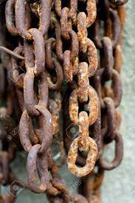
This Modern Slavery and Human Trafficking (MSHT) safeguarding resource has been designed to help worshipping communities around the world establish good child welfare practices, enable them to respond well to concerns about MSHT, and take action to reduce risks in their communities.
This resource is designed for use by senior leaders, to help them ensure there is a good foundation for worshipping communities to raise awareness, ensure projects are run safely, and act on MSHT.

Slide 3
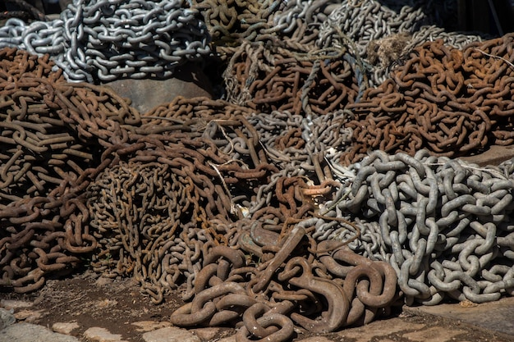
What is Modern Slavery and Human Trafficking?
In pairs discuss what you think is Modern slavery and human trafficking ?
Feedback to a plenary discussion key thoughts
Notes:
Spend 5 minutes having a discussion in pairs then 10 minutes to feedback

Slide 4
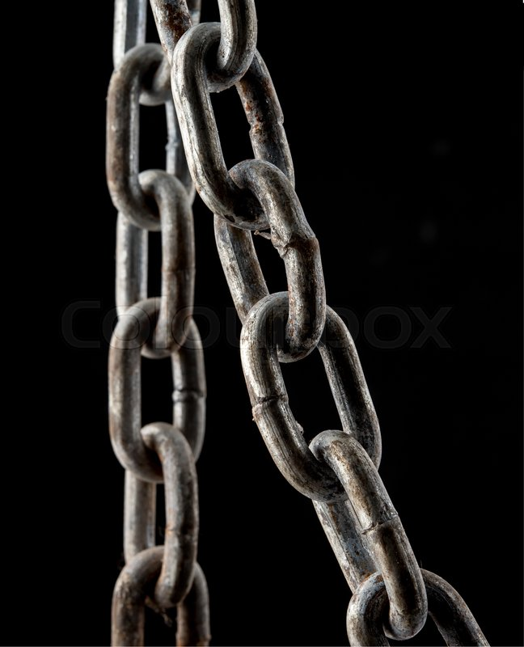
What is Modern Slavery and Human Trafficking?
MSHT is a form of abuse which involves the exploitation of a person to the benefit of another. The effects are significant. Individuals can experience high levels of psychological and physical trauma, and can find it hard to seek help. Often the services may not be available. MSHT is a global issue worth billions of dollars to the exploiters.
Exploiters target those who are most vulnerable, for example children, women, people who are disabled, those living in poverty and people fleeing conflict or persecution.
Vulnerabilities to MSHT are increased by wars, humanitarian disasters, and global warming, which leave more and more people uprooted and unsafe.
Notes:
Read the information on the slide

Slide 5
Types of Modern Slavery and Human Trafficking
In pairs discuss what you do think are main types of Modern slavery and human trafficking in your country ?
Feedback to a plenary discussion key thoughts
Notes:
Spend 5 minutes discussing in pairs then 10 minutes feeding back

Slide 6
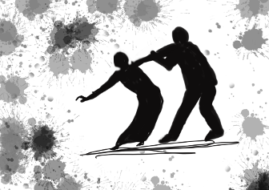
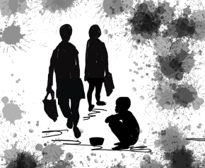
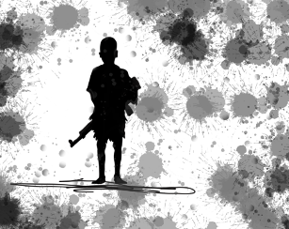
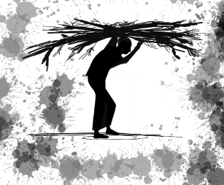
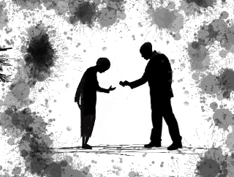
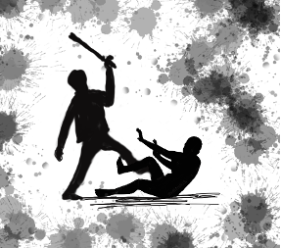
Types of Modern Slavery and Human Trafficking
Notes:
Show the pictures and ask the group for their thoughts.
Your country will have its own laws about what is acceptable. Here are some common concerns that people in Tanzania have raised:
Women and girls leaving from the villages to big city after a promise of work/better life. Often losing contact with family and friends. It is thought they are being trafficked. Some women and girls have escaped and come home and have given testimonies to this effect.
Children being expected to do work which is not appropriate for their physical/mental ability.
Children not being paid for work.
Forced marriage.
Children missing out on education due to work.
Domestic servitude and sexual exploitation are key issues for women and girls.
Climate change is causing crops to fail and worsening poverty in some areas. This is increasing exploitation.

Slide 7
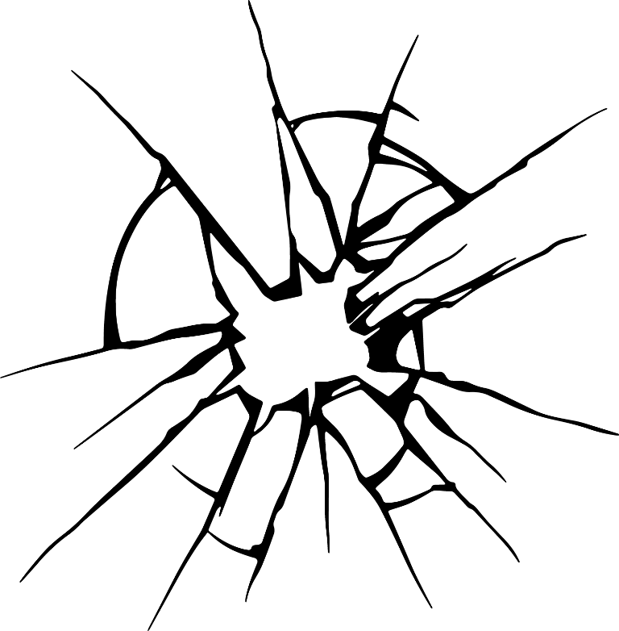
Definitions of Key Terms and Types of Abuse
Child labour
Gender-based violence (GBV)
Intimate partner violence/domestic abuse
Trafficking of children
Trafficking of adults
Child abuse
Child neglect
.
Physical violence
Psychological/emotional abuse
Child sexual abuse
Notes:
Talk through the definitions and terms. Ask the group if they have heard any of the terms before and what they know.
Child abuse
Contravention of the rights of the child which causes physical, moral or emotional harm including beatings, insults, discrimination, neglect, sexual abuse, and exploitative labour.
Child neglect
Failure of a child’s parent or caregiver to provide necessary care and means of sustenance to a child such as food, shelter, clothing, education, medical care, etc. Or failure to protect such a child from violence by parent, guardian or child care institution.
Physical violence
Physical acts of violence such as being slapped, pushed, hit, kicked, or whipped, or threatened with a weapon such as a gun or knife.
Psychological/emotional abuse
Verbal and non-verbal emotional abuse, which may be active or passive. This describes actions intended to inflict mental pain or distress on a person.
Child sexual abuse
Contacts or interactions between a child and an older or more knowledgeable child or adult (a stranger, sibling or person in position of authority, a parent or a caretaker) when the child is being used as an object of gratification for the older child’s or adult’s sexual needs. These contacts or interactions are carried out against the child using force, trickery, bribes, threats, or pressure.
Child labour
Any work that deprives children of their childhood, their potential and their dignity, and that is harmful to physical and mental development. It refers to work that is mentally, physically, socially or morally dangerous and harmful to children.
Gender-based violence (GBV)
Refers to any physical, psychological, sexual or economic violence perpetrated by a person against another on account of gender.
Intimate partner violence/domestic abuse
Behaviour within an intimate relationship that causes physical, sexual or psychological harm to those in the relationship, including acts of physical aggression, sexual coercion, psychological abuse, and controlling behaviours.
Trafficking of children
The recruitment, transportation, transfer, harbouring, or receipt of persons for the purpose of exploitation. Some of the types of exploitation are child sexual exploitation and forced labour including domestic work.
Trafficking of adults
The recruitment, transportation, transfer, harbouring, or receipt of persons for the purpose of exploitation.

Slide 8
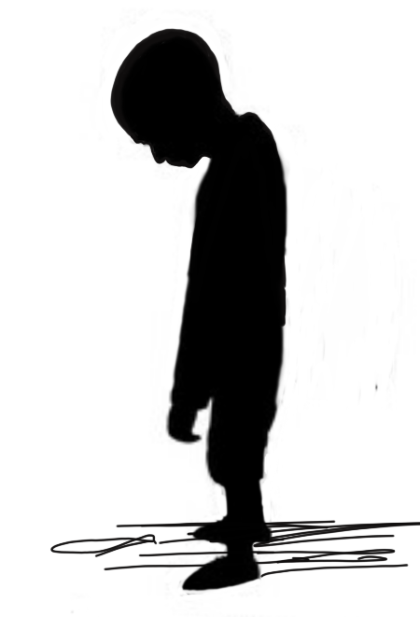
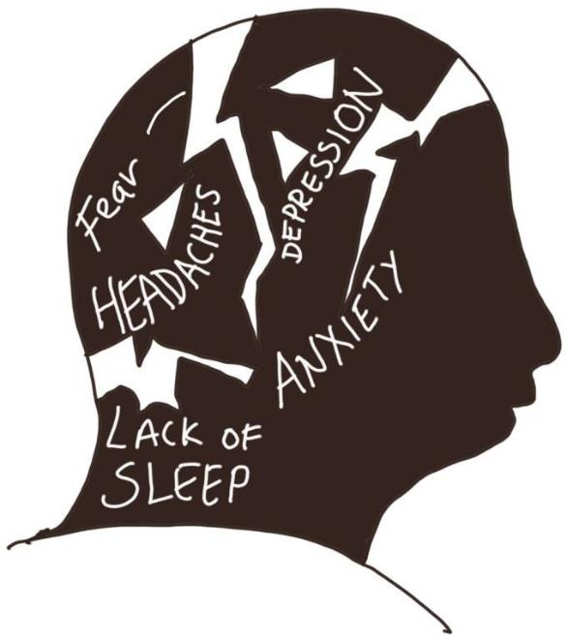
What are the effects of child abuse?
Anxiety
Lack of sleep
Depression
Headaches
Panic attacks
Self-harm
Fearful
Withdrawn
Poor health
Poor nutrition.
Notes:
The effects of child abuse are significant and can be life long.
Many studies have researched the impact of abuse on children. It causes children and families to suffer and can have long term consequences. The stress of abuse can lead to impaired brain development. If this is extreme, the development of the nervous and immune system can be affected.

Slide 9
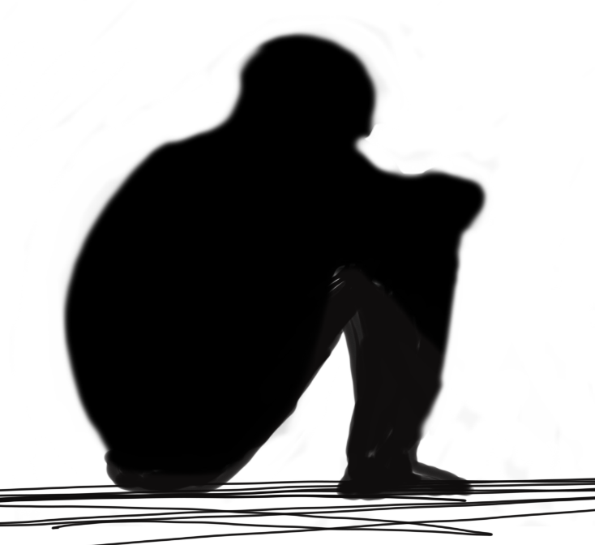
What Children Might Feel
  Don’t understand that they have been abused
  Believe they are in a relationship with their abuser
  Feel guilty and ashamed about their abuse
  Feel they have played a part in the abuse or they are the ones who have broken the law.
Notes:
Read out the information on the slide

Slide 10
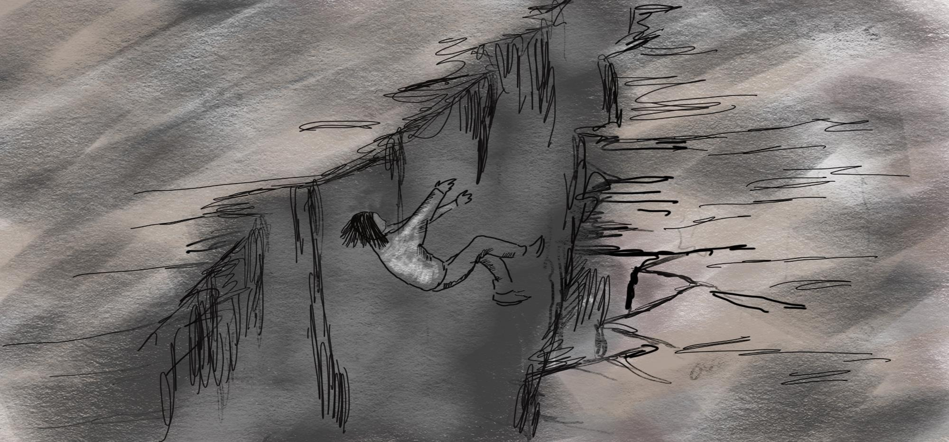
How to spot signs of abuse:
See a mark, bruise, burn, or injury which is unexplained or does not have a good explanation
You notice a medical problem which is not treated
You notice a change in a child’s behaviour
A child might tell you they are being abused
You might notice an adult abusing a child
You may see a child’s appearance change and get worse, e.g. dirty clothes and they are not clean
A child may become pregnant or have signs of sexual abuse for example pain in their genital area.
Notes:
Its important that we create a culture of vigilance. There are many different signs of abuse but here are some to be aware of. Just because you notice one of these signs it does not mean a child is being abused but observing a sign should be a prompt to ask the child how they are and to be alert to other signs.

Slide 11
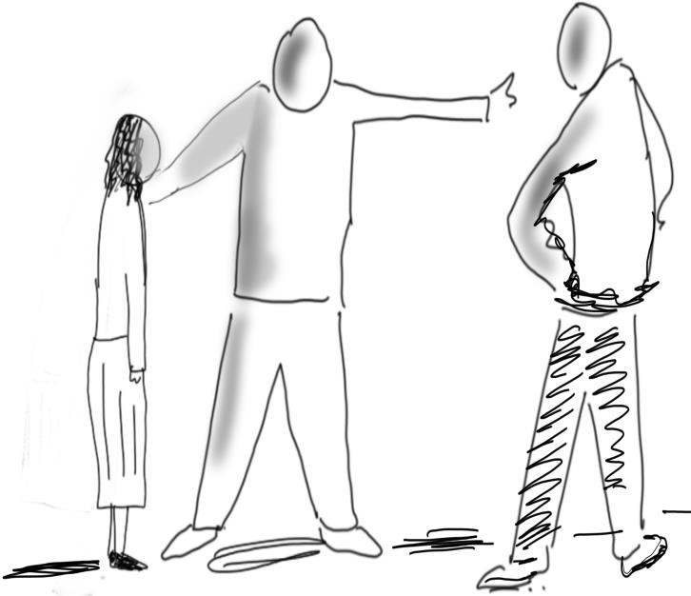
Case studies
Look at the two case studies ( Forced marriage and child labour )and discuss the impact on children’s wellbeing, health, eduction and future life and opportunities ?
Discuss in small groups and then share key insights back to main group
Notes:
Refer to the resource

Slide 12
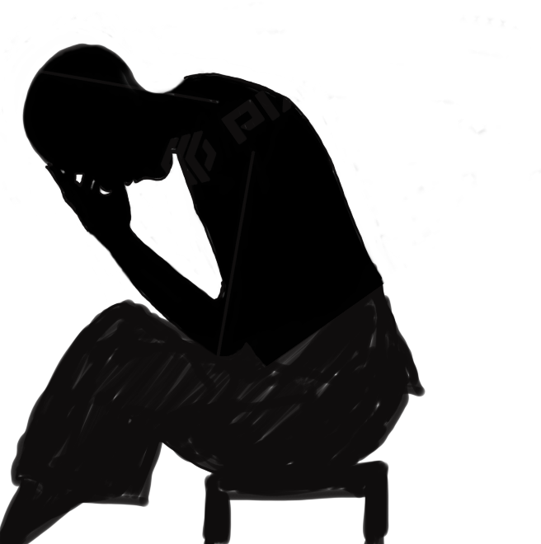
Forced marriage?
What Are the Causes of Forced Marriage?
key drivers are gender inequality and poverty:
Gender inequality: Deep-rooted patriarchal beliefs, the low value placed on girls, and the desire to control women, especially girls’ sexuality, underpin child marriage.
Social norms that value boys over girls mean parents might not think it worthwhile investing in their daughter’s education.
Poverty: For poor families with many children, marrying their daughter off early can mean one less mouth to feed. In addition, there is also a financial aspect due to dowry and bride price traditions.
Notes:
Talk through the information on the slide and refer to the resource for further information. Ask the group if they think forced marriage is an issue in their country or community.

Slide 13
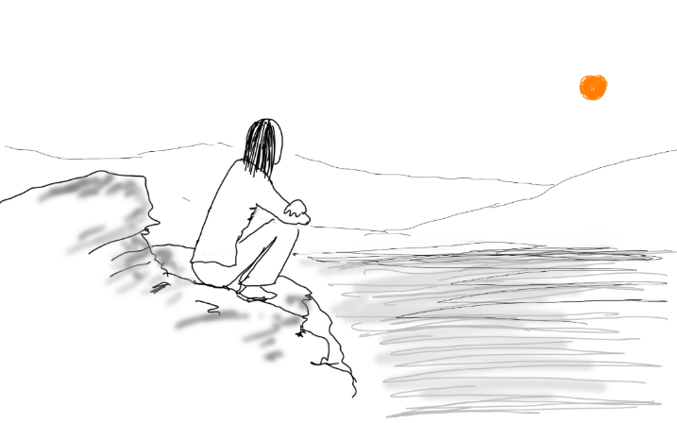
Bible Study: Psalm 139 – The Sanctity of Human Life
Read the passage.
Ask your group(s) to read the passage for themselves and answer the following questions:
What strikes you most about this passage?
What do you learn about the preciousness of life from this passage?
How does God see all people regardless of their age, gender, tribe, status?
What role should we have in ensuring all lives are cared for and protected as God intended?
Notes:
Group discussion – 10 minutes – refer to the resource for further information

Slide 14
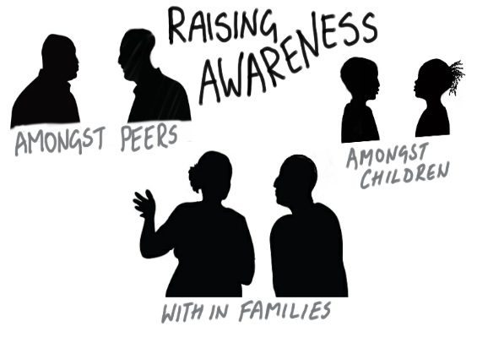
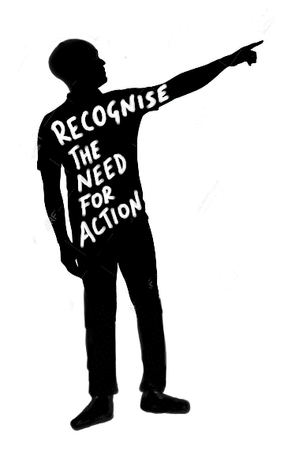
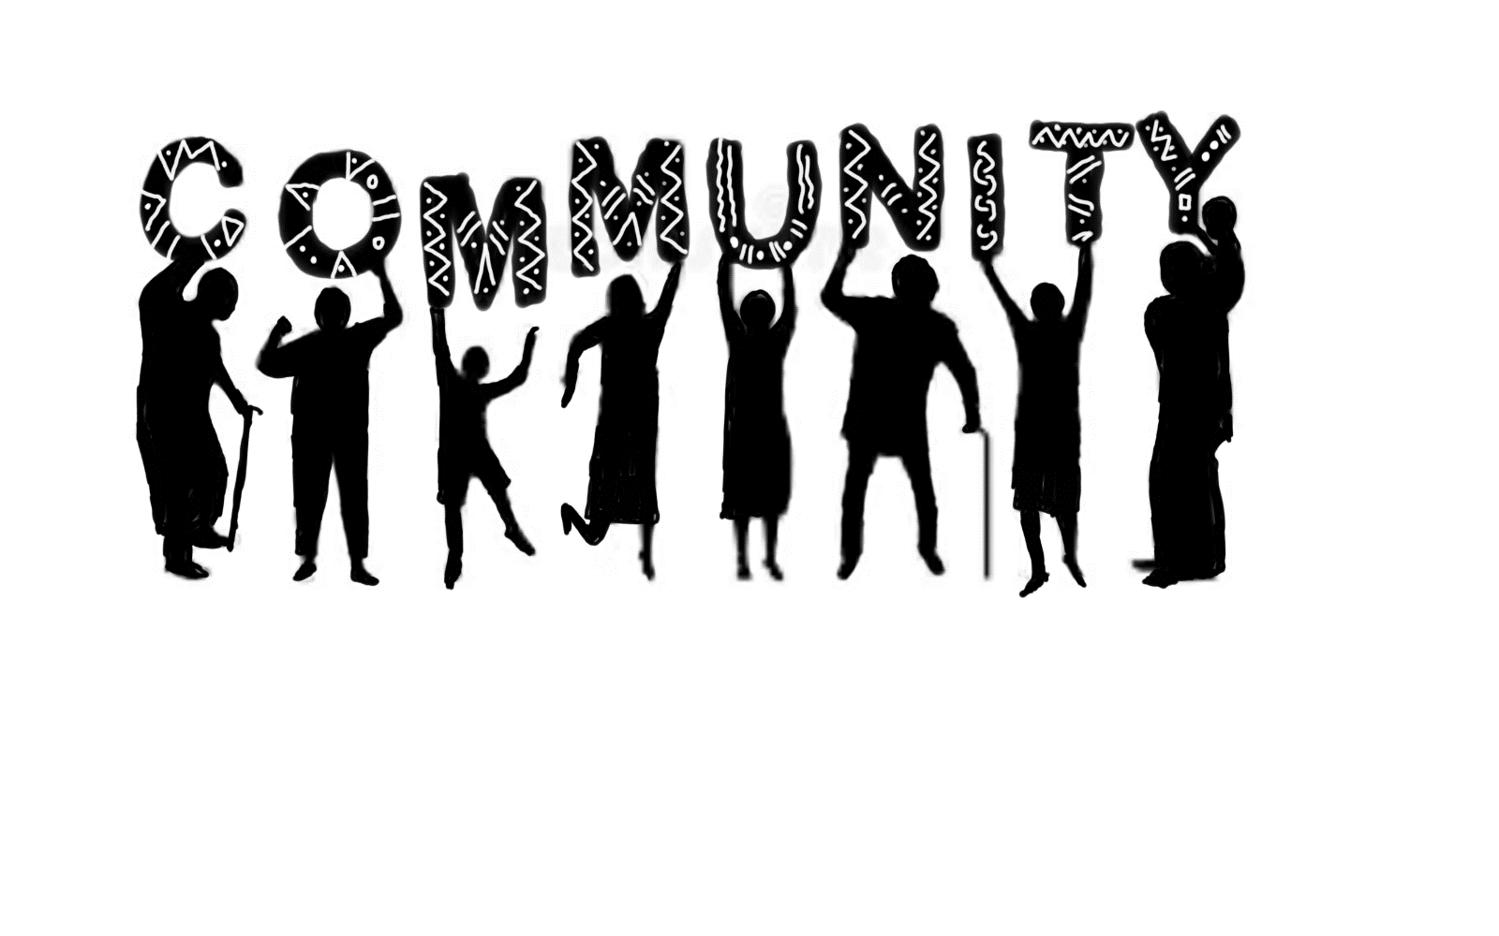
How can worshipping communities help?
Notes:
Refer to the resource for further information

Slide 15
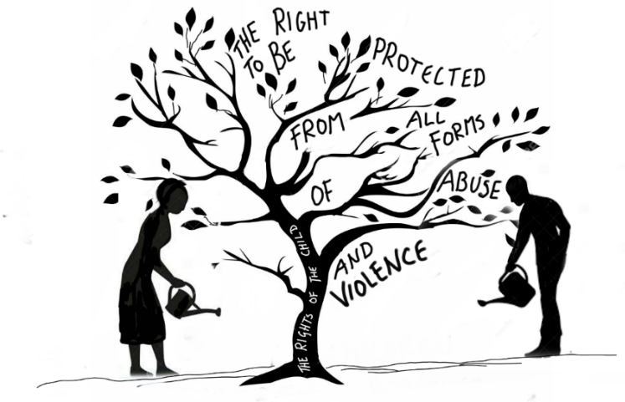
How can children and young people be involved
in raising awareness
Notes:
Refer to the resource for further information

Slide 16
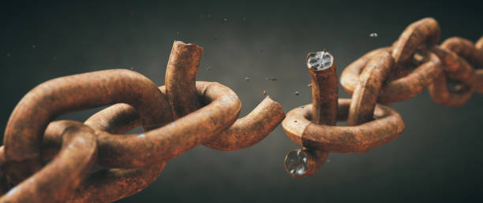
Taking action
What have you heard that has been important ?
How do feel about this topic ?
What can “we do” as a worshipping community to make a difference?
Notes:
Get the group to discuss in pairs for 5 minutes then feedback for 10 minutes

Slide 17
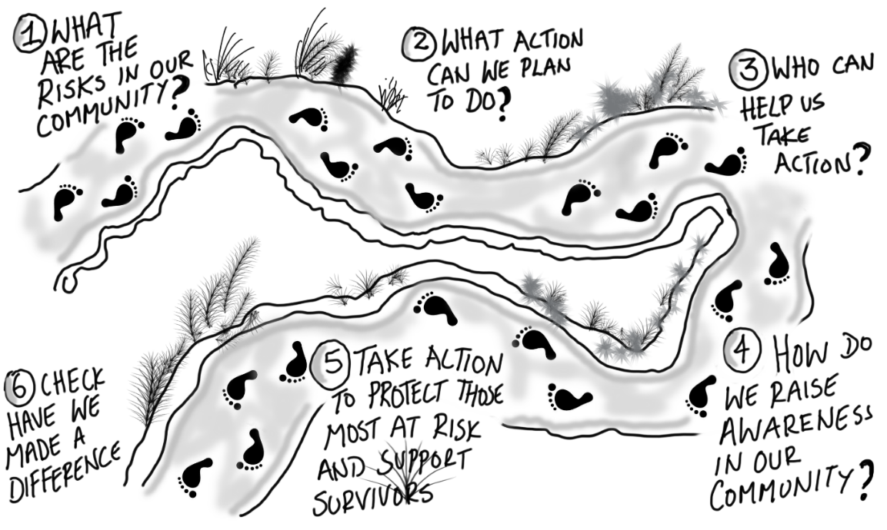
Overview of the key steps
Notes:
Talk through the slide

Slide 18

Action steps
Find out what the MSHT risks for your community
Make a plan of how you can help
Tell your workers about the plan and let them know how they can help
Tell your community and let them know how they can help
Take action to reduce risks for your community and to improve support for victims
Check how you are doing
Notes:
Talk through the slide

Slide 19
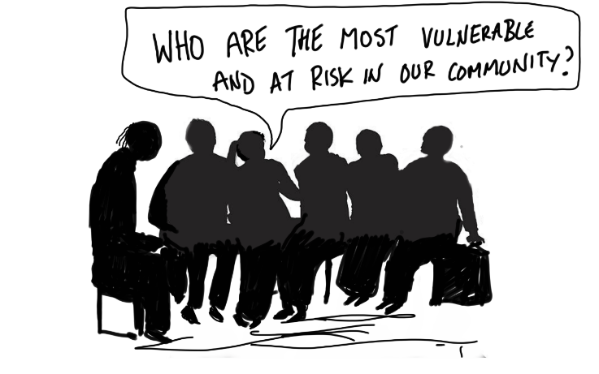
Action steps
Step 1 – Lead and collaborate.
Recognise the need for action.
Make this a key priority.
Find out what the MSHT risks are in your community/country. Consider who might be particularly vulnerable to MSHT in your community/ country.
Link with others who can help you with information and support for example: Government agencies, Police, Social worker, NGO, other faith leaders, those working with vulnerable people.
.

Slide 20
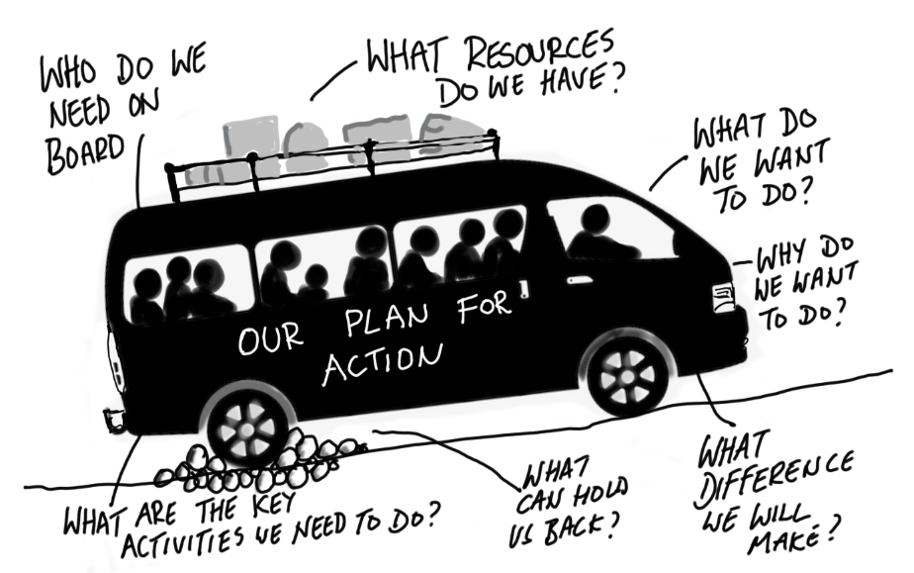
Action steps
Step 2 – Effective plan
Make a plan that fits for your context.
(See the sample action plan in Appendix 1)
Consider what policy, procedure and training you might need - a child welfare policy is a good place to start.
(Sample policy headings and a policy example in Appendix 2 if you do not have one in your organisation)
Make sure your plan is clear about how people should respond and who they should tell if they are concerned.
Think about how you can contribute to reducing risks.
.
Notes:
Talk through the slide

Slide 21
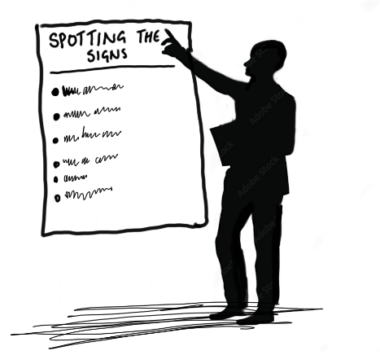
Action steps
Step 3 – Train and educate workers
Make sure your workers are aware of the risks and supported to act.
(Sample seminar agenda in Appendix 3)
Educate your workers to recognise the signs of MSHT and how to respond well.
(Signs and symptoms poster in Appendix 4, Responding well poster in Appendix 5)
Step 4 – Educate your community
Educate your community including those who might be vulnerable (e.g. refugees, orphans, those facing poverty)
(Sample seminar agenda in Appendix 3 sample posters in Appendix 4/5/6/7)
Notes:
Talk through the slide

Slide 22
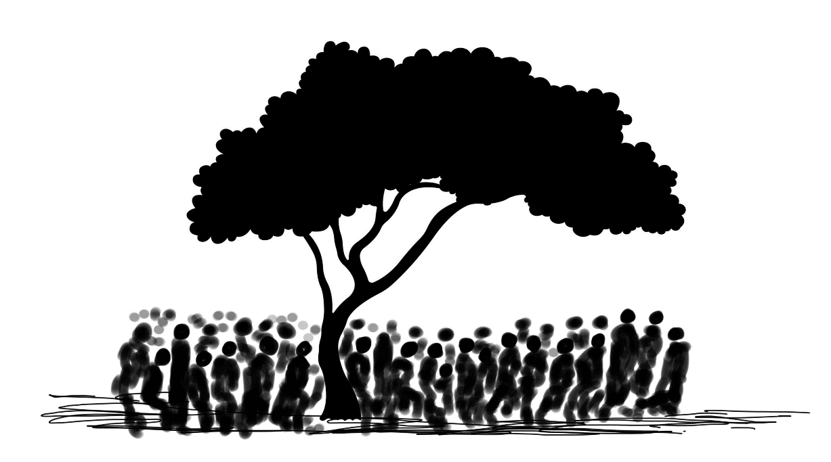
Action steps
Step 5 – Take action to prevent MSHT in your community.
Take action to build community and individual resilience.
Educate your community to help encourage individual and collective responsibility and to help individuals to protect themselves.
Think about ways you can empower those who are most vulnerable.
(Examples of action in Appendix 8)
Notes:
Talk through the slide

Slide 23
Action steps
Talk through the table below and discuss the ideas people have for each section
Time frame | What can we do in the next 3 months | What can we do in the next 6 months | What can we do in the next 18 months
Engaging our community
Raising awareness in our community
Protecting the most vulnerable in our community
Notes:
Take 10 minutes to go through the table as a group

Slide 24
Taking action
“Never doubt that a small group of thoughtful, committed citizens can change the world; indeed, it’s the only thing that ever has.”
Margaret Mead
Notes:
Talk through the slide
Thank participants for attending
Agree your next steps

